Slide 1

P r o b l e m S t a t e m e n t
In the fast paced world of increasing demand of customer expectation in customer service, it is essential to analyze the factors that will effect to improve turn around time in resolving a customer complain.
As data security is a concern, so the middle and junior management team in service operation takes decision mostly based on their intuition and past experiences and not driven by data. This is effecting a delay in decision making process and understanding of actual problem in field.
Our goal is to use data-driven insights to help the field service management team with effective ready to click interactive dashboards, for easy anomaly detection and take faster counteractive measures in field operations.

Slide 2
Research Question
- Is there any relation of below factors with call resolution Turn Around Time
Customer Location
Location wise Field Service Engineer Availability
Productivity of each Field Technicians
- Is there any relation to technicians with repeat failures
- Understanding of count of failures in comparison to product category
Understanding that Data security as a primary objective will be compromised or not

Slide 3
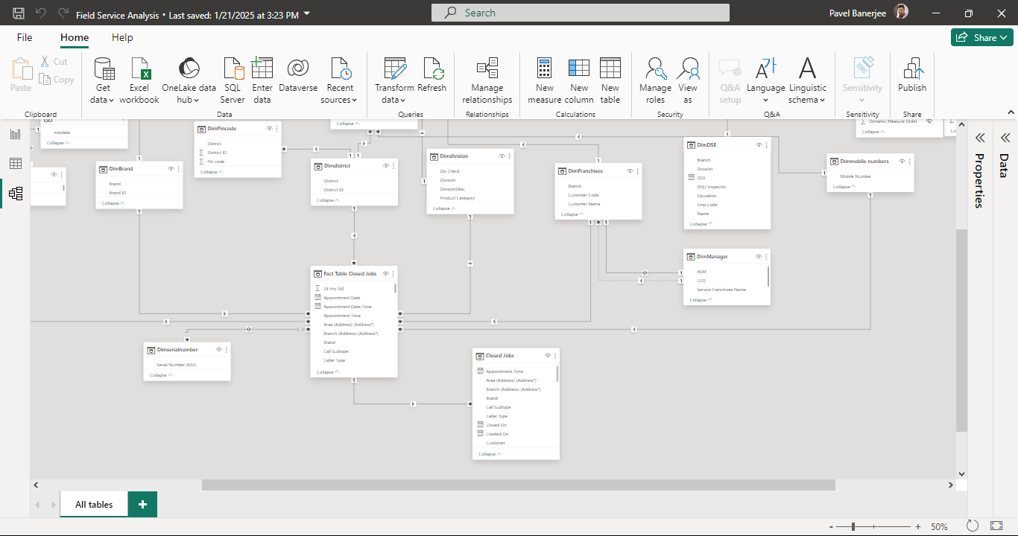
Data Overview
For this analysis, we have used comprehensive dataset of Closed complain report of Havells division, used data cleaning and made fact and dimension table to make effective modelling of the raw data to consolidated columns in POWERBI for our investigations.

Slide 4
Methodology
Steps | Description
Fact Tables | Active jobs and Closed jobs tables made by removing dimension columns and merging the dimension tables with foreign IDs from dimensions
Dimension Tables | 1) Dimbrand 2) Dimdivision 3)DimDSE 4)Dimpincode 5)DimFranchisee 6)Dimcalendar 7)Dimdistrict
Modelling | Snow Flake Schema modelling made with fact and dimension tables
Calculated Columns | for calculation of 24 Hrs TAT
Calculated Measures | for calculation of Average Response,Average TAT, Count of consumer,count of dealer,Technician Count,Target TAT,Complain closed per Day,Ideal Technician Count,Total Technician Count
Calculated Table | Fact Vrs Dimension Table

Slide 5
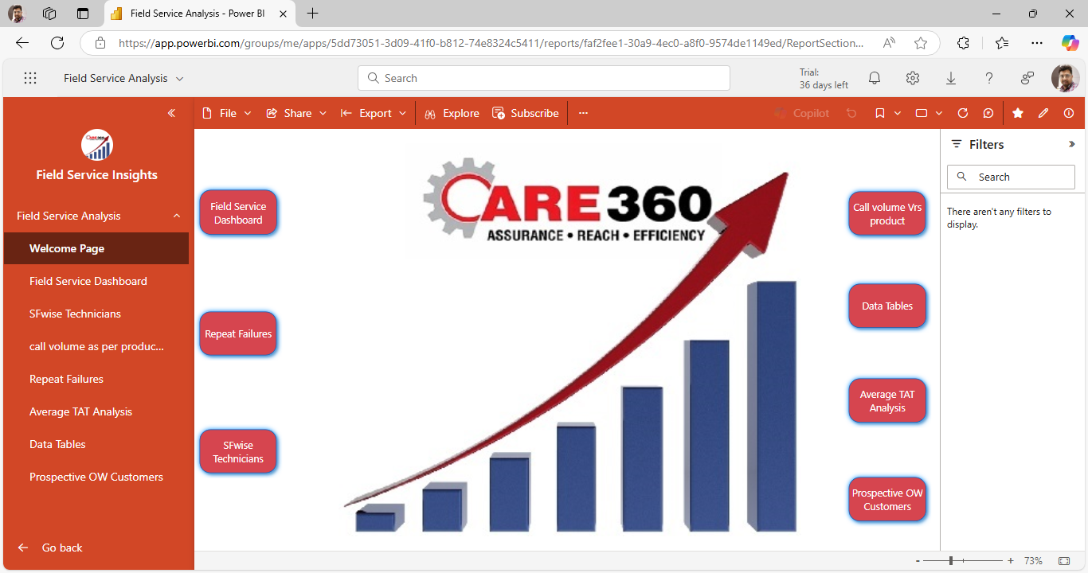
Welcome Page
A welcome page has been created from where other slides can be navigated directly by clicking buttons

Slide 6
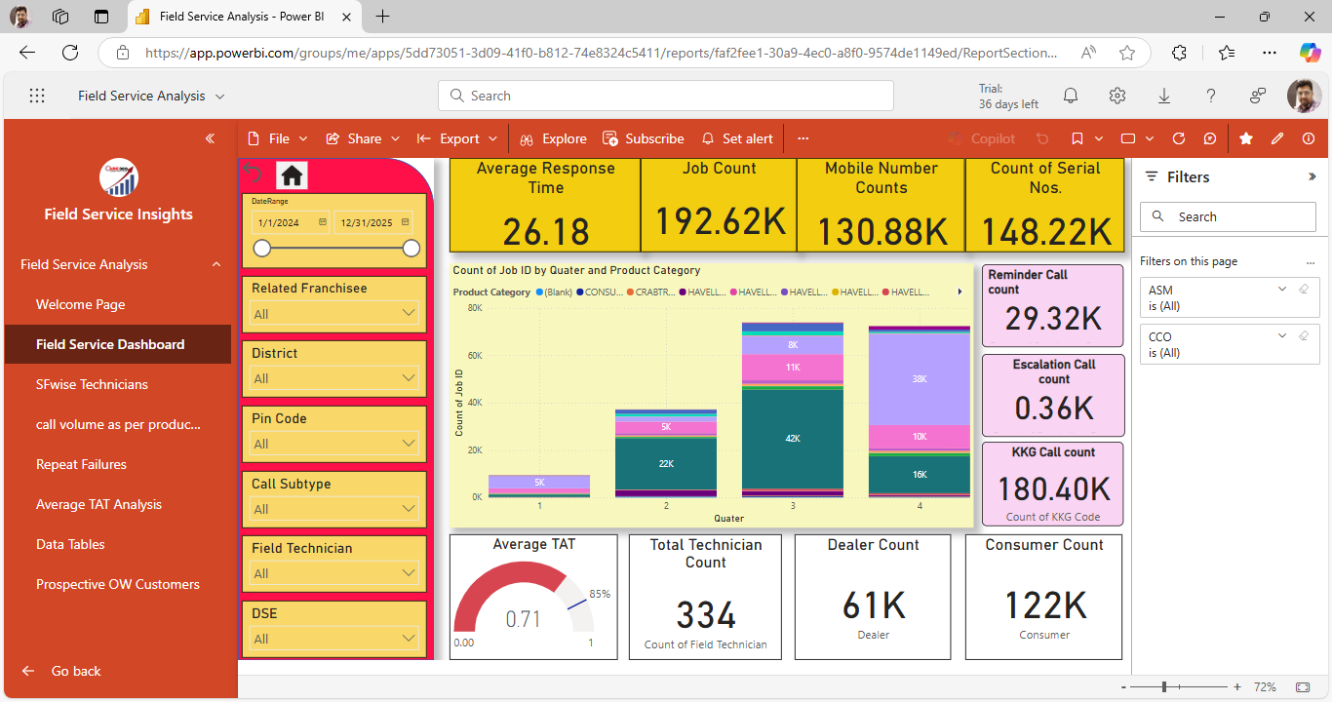
Journey Insights
It is found that the customers are not contacted within one hour of call receipt leading to reminders and dissatisfaction
Top failure products found are in fan and mixer grinder category
Few technicians producing abnormal repeat failures in specific areas.
Product category call volume differed quarter wise indicating seasonality of products
Field Service Dashboard

Slide 7
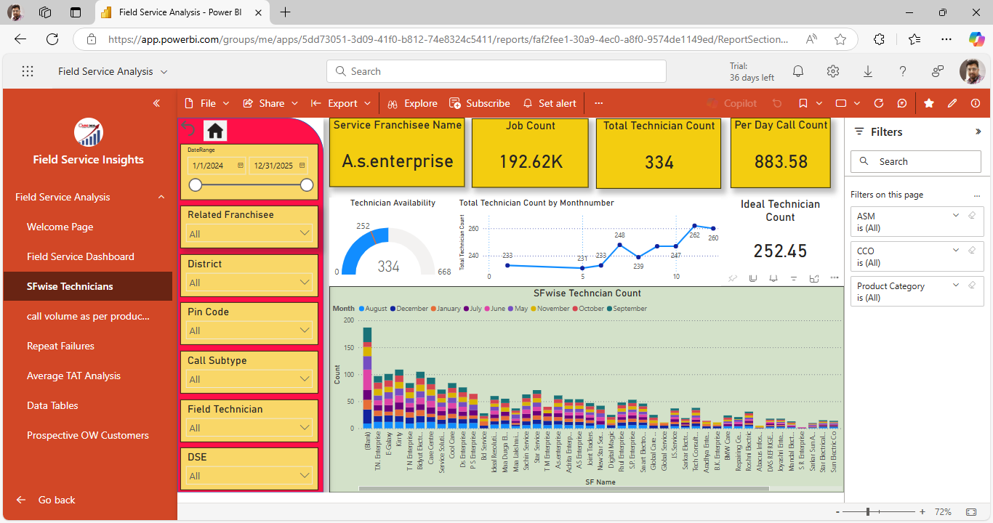
Ideal Technician count Vrs Physical Availability Franchisee wise
SF wise Technicians

Slide 8
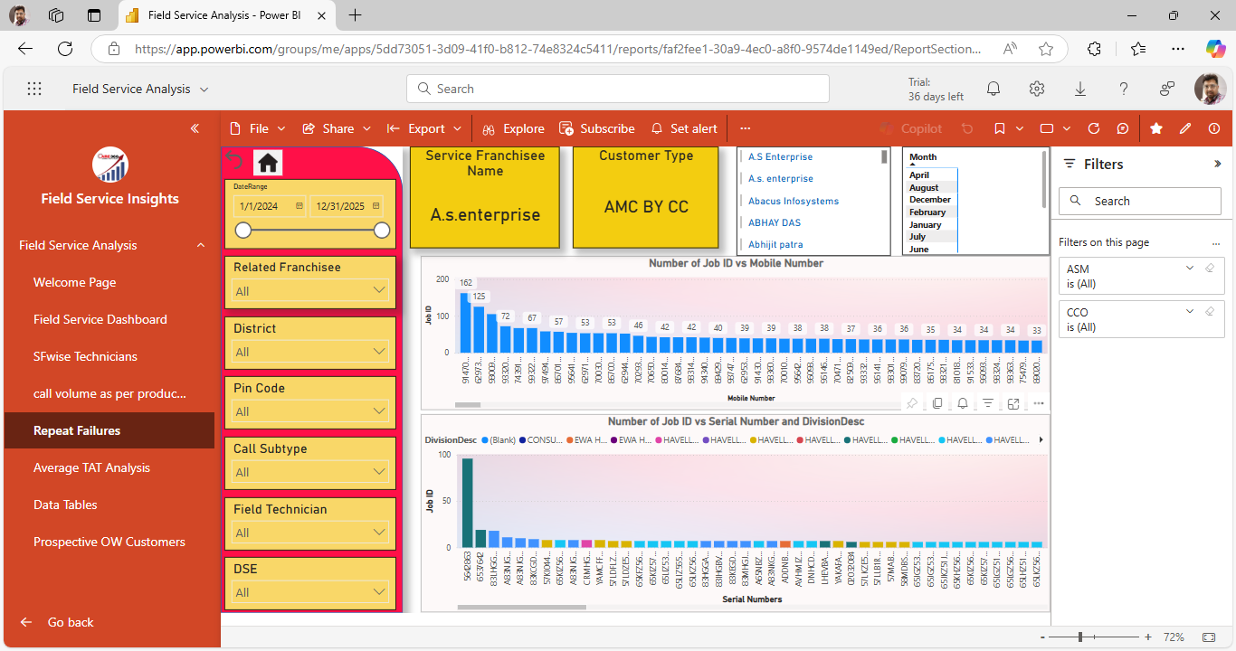
Repeat Failures and auditable insights Moreover repeat of serial numbers vrs customer ID is mentioned with technician name to highlight the abnormal repeat failures. All Filters in form of slicers are given in left side to analyze as per date range, service franchisee name, district, pin codes, Field technician name.
Repeat Failures

Slide 9
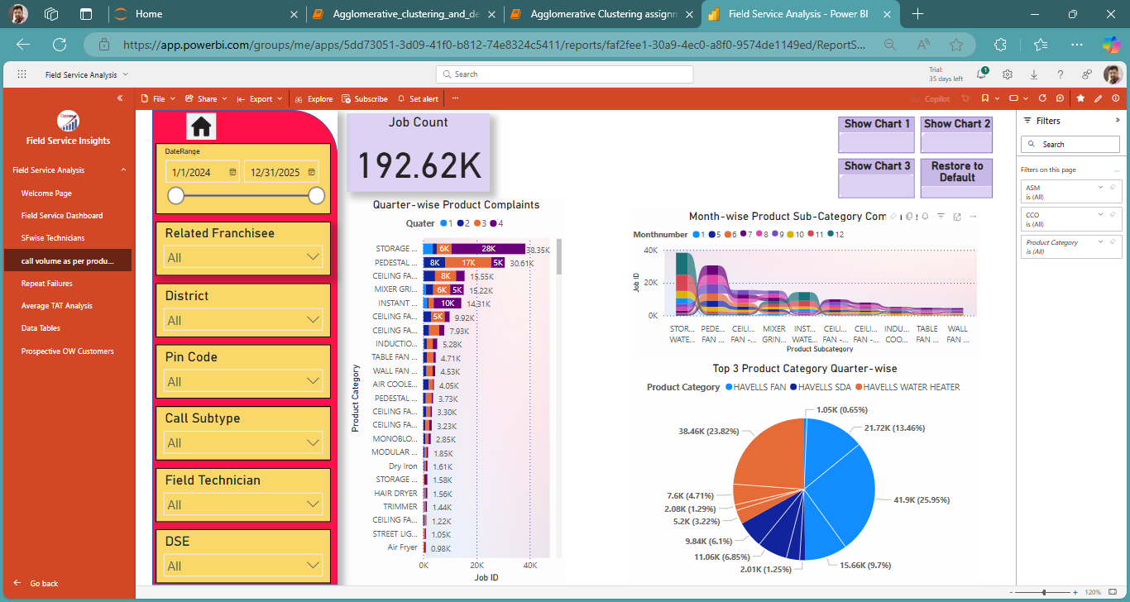
Pincode wise and district wise top 5 product category complains can be accessed , which help to plan effective MSL at Franchisee level which may differ from market to market
Call volume as per product category

Slide 10
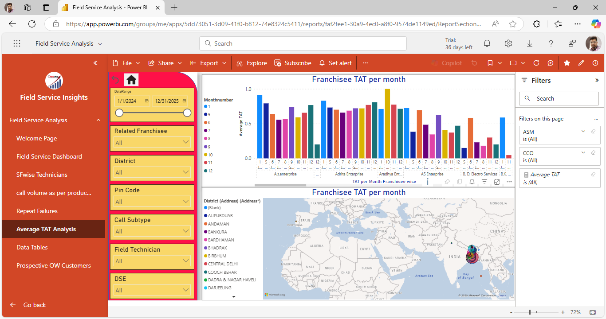
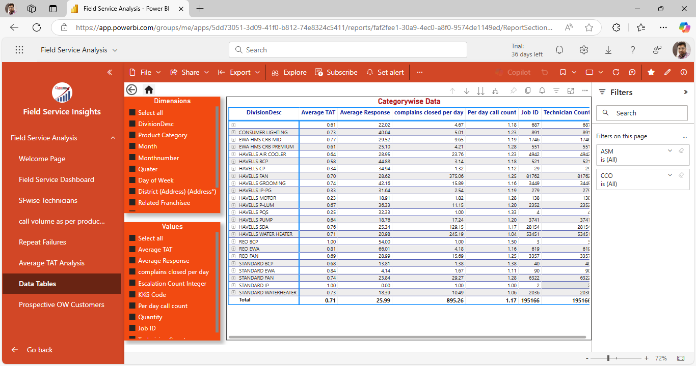
Data Security Access to the report is limited to the respective managers responsible for respective areas or zones product categorywise. All access to reports is given only to National Heads only. Alerts are set on the reports in form of mails if achievement gets below the target. Users can access the report through Apps.
Pin code wise TAT Analysis
Dynamic Report Chart

Slide 11
A reference table is shown which can be altered dynamically by selecting the required fields in the slicer side pane with area wise , date wise incoming call counts per day, average TAT per day, techncian counts etc
Dynamic Report Chart

Slide 12
Recommendations and Conclusion
Users get daily reports and access with pin code level penetration to all achievements without any direct access to secured raw data.
Any anomaly in the field can be detected on cards
Any failure to meet the target will be highlighted instantaneously
It will help to make futuristic forecasting of complains and plan effective utilization of resources – Manpower and Spares.
Reports helps to make strategic approach to the exact problems highlighted for any shortage of resource leading to failure to achieve target in any location.
It is recommended to meet the ideal target technician count service franchisee wise to avoid any delay in TAT or overloading of complains in any location.
Top ten failure products are highlighted to take appropriate actions in training of manpower and effective spare availability

